Slide 1

Unsupervised clustering exploration to help Bank of Z understand its credit base
Second Round FedEx Interview

Slide 2

Executive Summary
Mission: Bank of Z wishes to investigate credit user data in order to understand how they can differentiate spending patterns in the various credit groups
Objective: Using an unsupervised learning approach understand the credit user base in order to inform employer, Bank of Z, on credit use patterns of a group of credit consumers
Implementation: Leverage the power of K-means clustering in order to break out groups, and understand patterns within the various credit groups
Analysis: Issues encountered during analysis were with NaN data and “0” data. While 0’s were in-fact data, they were making the clustering workflow difficult to usefully interpret. Data also needed log norm filter due to skewed nature
My solution was to eliminate “0” data and drop all null data. For model evaluation I look at the silhouette coefficient, and used elbow plot method to determine optimal cluster number. I then used PCA to visualize clusters
Outcome:
Highest credit limit group was responsible, making the most payments and not carrying the highest balance. Marketing could reach out more to inquire about interest in new lines of credit or inquire about interest in a limitless card option
Second highest group was carrying the highest balance but making nearly the least amount of purchase/payments. This group could benefit from a purchase incentive program, offering double triple points for every purchase etc. Outreach on a personal loan program or home equity credit lines
The 3rd tier credit limit group had a lower credit limit and balance and made lots of small purchases. Outreach from marketing to increase credit limits in this group could incentivize to make larger purchases.

Slide 3
Credit Group Breakdown
Bank of Z
3
1
2
Highest credit limits
Lowest credit limits

Slide 4
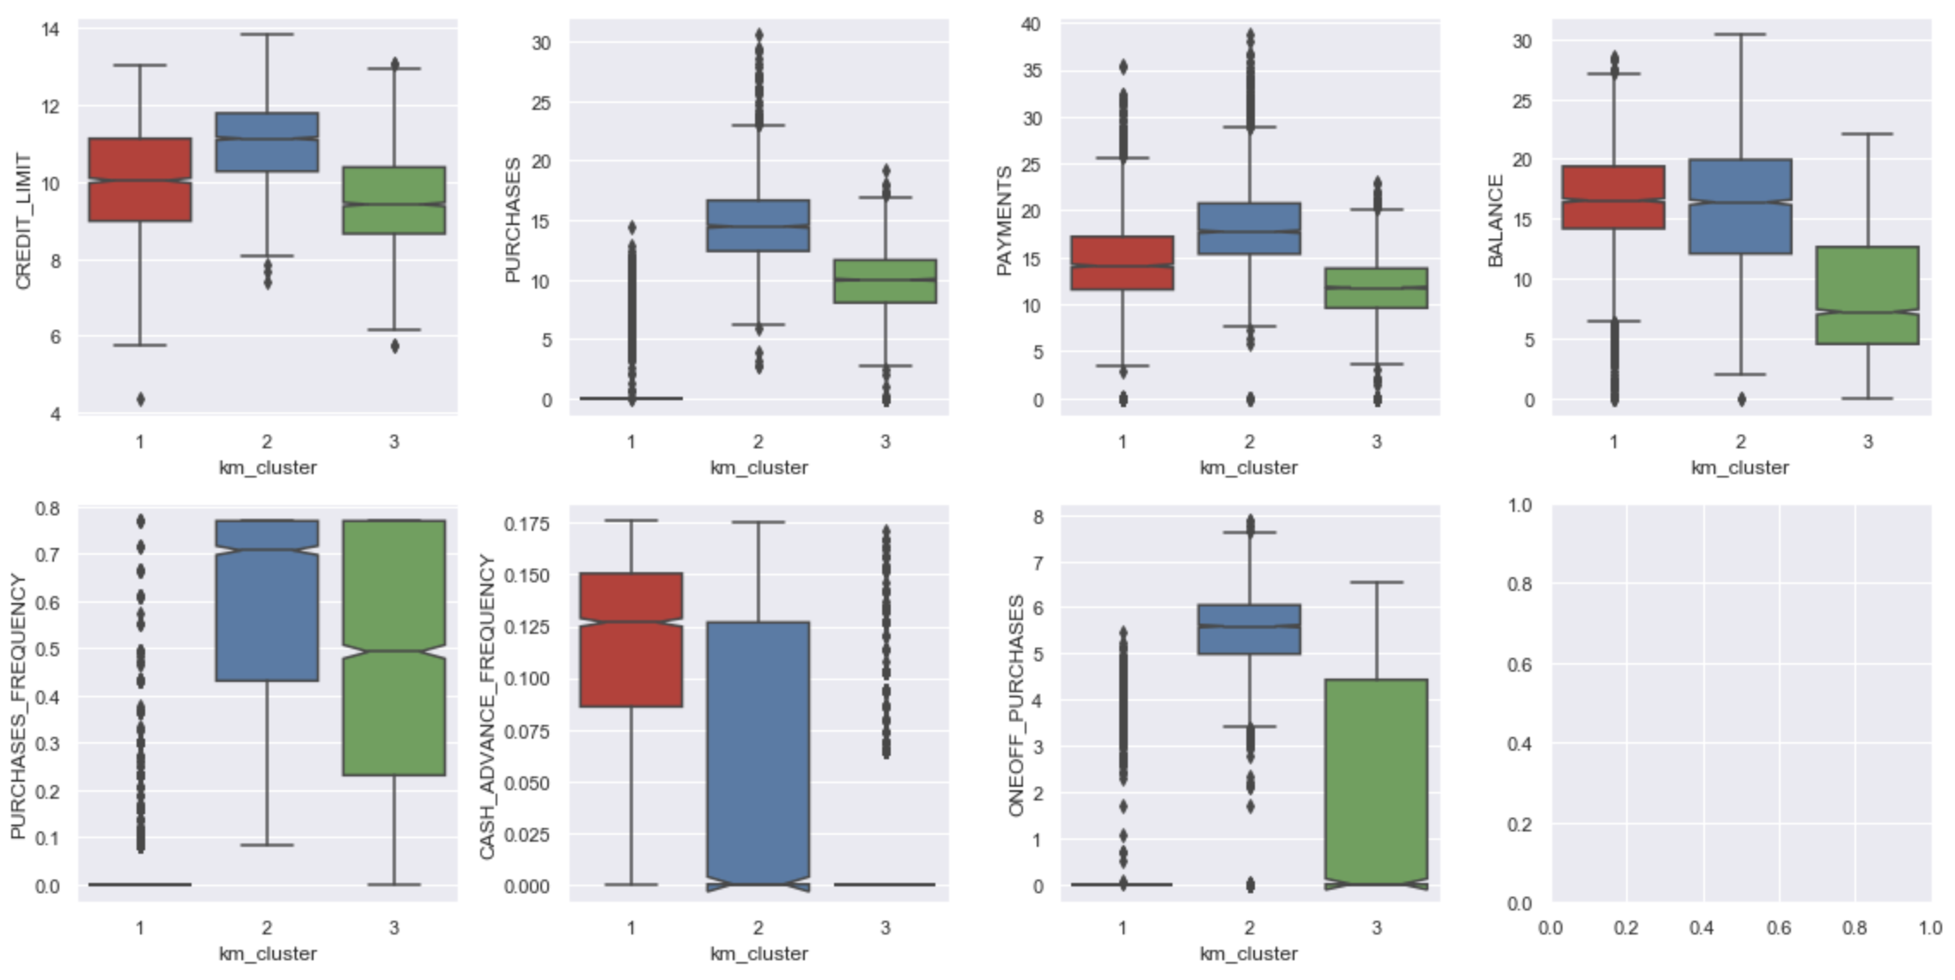
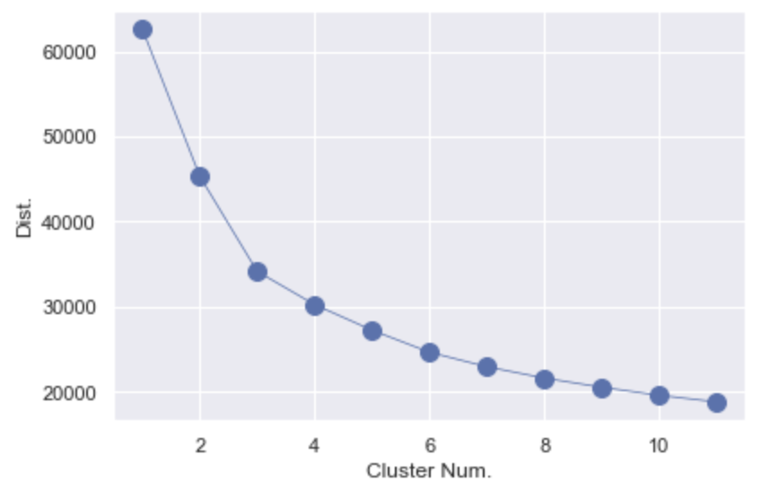
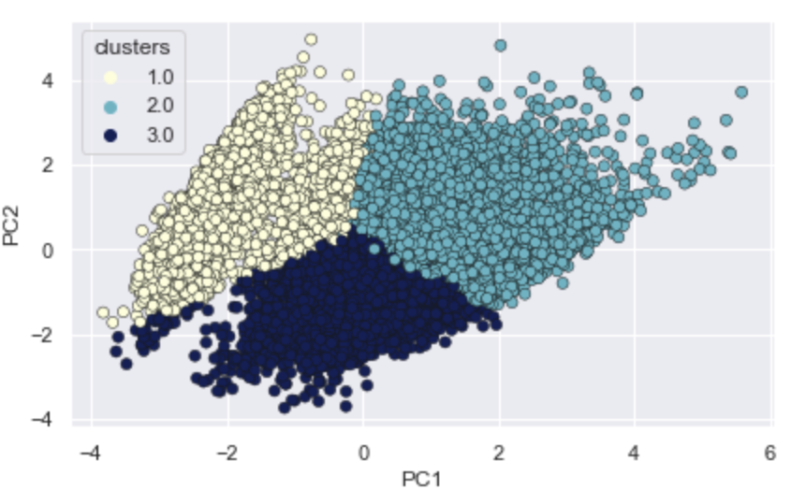
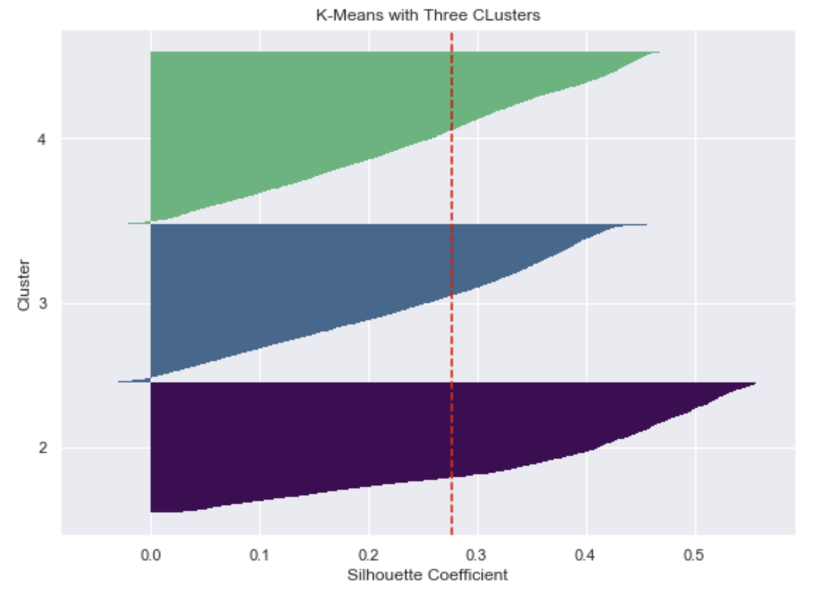
Methodology
Used Kmeans clustering to group the credit users
To visualize the group segments I employed a boxplot graph
Then to evaluate the clustering I looked at the silhouette score: a positive value up to 1 implies the observed value is like other observed values in cluster, and a neg. value to -1 implies the opposite
Here we can see the outlier data moving negative in some of the clusters
3 PC’s accounted fro 92% of the variance

Slide 5
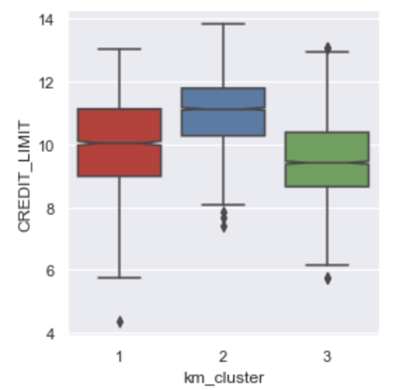

Credit Group 1
Highest limit
Largest purchases
Largest payments
Tied highest balance
Mission – advertise new no limit card offers to this group to attempt to incentive them to spend more, more often. Investigate online purchase frequency

Slide 6
Credit Group 2
2nd highest limit
Nearly highest balance
Second highest purchase amount and payment amount
Highest cash advance group
Mission: advise Bank Z to monitor this group for personal loan outreach or home equity credit line outreach. Strategize ways to incentivize group to make frequent credit card purchases

Slide 7
Credit Group 3
3rd highest limit
lowest balance
Purchases and Payments seem to be in line with each other
Consider advertisements for credit limit increases to current cards
Mission: collect more data on this group to understand spending patterns purchse and payment patterns are very tight, so investigate purchase categories and see if a new or different type of card would incentivize purchases. Entertain credit limit increase

Slide 8
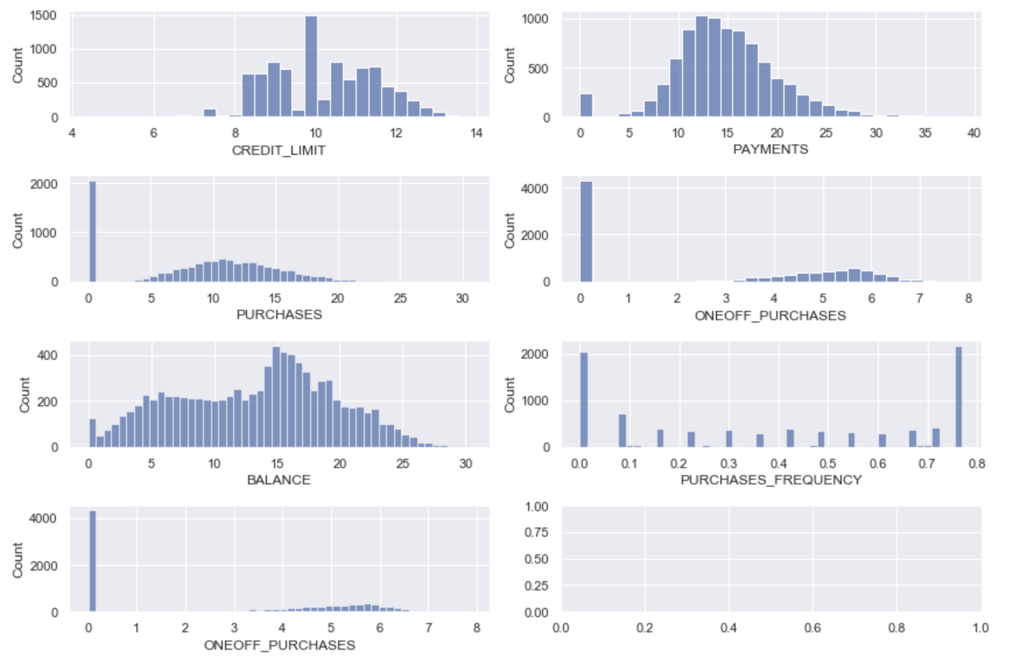
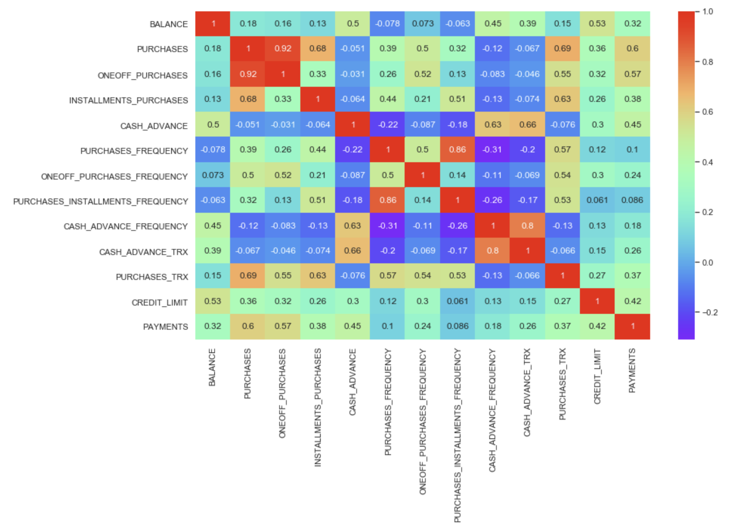
Analysis
The data set had several null values that needed to be cleaned
There were lots of “0” values that caused cluster analysis to be difficult, so they were removed
Heat plot was used to visualized correlations across all datasets
The data had a highly skewed nature that required log norm adjustment
Selected cluster count with elbow plot
Used boxplots to visualize the clustering results, and guide interpretation
Used silhouette coeff to understand cluster selection
Used PCA with 2 components to visualize clusters
Accounted for 84% of variance (3 PCs accounted for 96% of variance)

Slide 9


Conclusion
?
Bank needed to segment its credit consumer base to begin understanding patterns in the various groups
Unsupervised clustering work revealed 3 distinct groups with unique credit use patterns
Continued data collection is advised but there are some emerging trends in credit use that can be used for outreach and marketing
Investigate other types of clustering workflows to see if there is a better way to break out the group – Hierarchical clustering might be a next step
Determine if there might be a better way to handle the null data; a insert median value operation might provide more useful data; investigate if running data through a log norm operation was overkill and if the skewed data might be more informative on the individual clusters of credit users

Slide 10
Thank you for your time Questions?

Slide 11
Supplemental
I implemented an Unsupervised clustering of data then fed results into a supervised workflow to train an inferior dataset to reconstruct the facies log I was able to build with the cluster labels
The supervised workflow was an ensemble WRF model and was evaluated on RMSE since it was a regression model and I felt that was a sufficient evaluation metric. RMSE was based on a regression between predicted oil production and actual production in the train and test sets
The final product was used to guide subsurface mapping efforts and high grade company acreage based on a correlation to a certain facies and well productivity
In addition the model allowed us to visualize lateral distribution of containment facies in the subsurface which helped us to tailor our development strategy in certain areas
I was not able to legally share these models today due to an ongoing acquisition and short timeline on project submission(legal dept wouldn’t have gotten back to me until after holidays)

